Slide 1
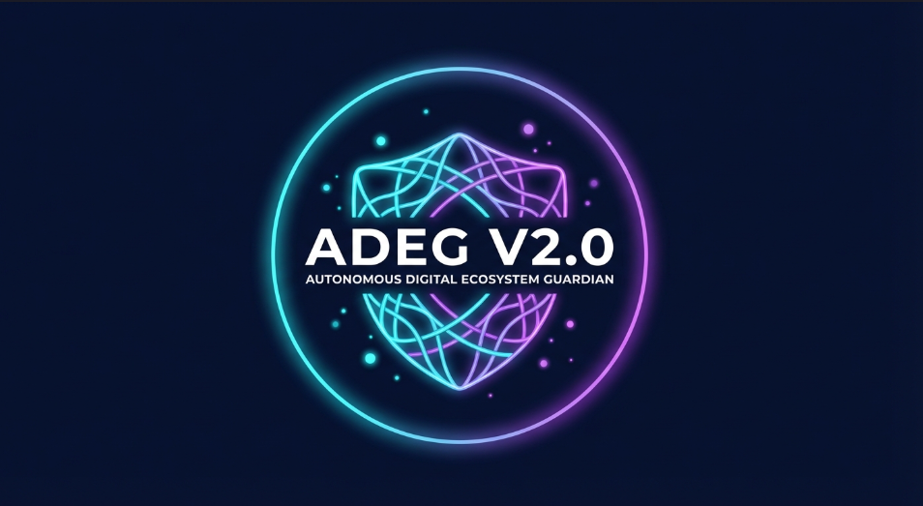
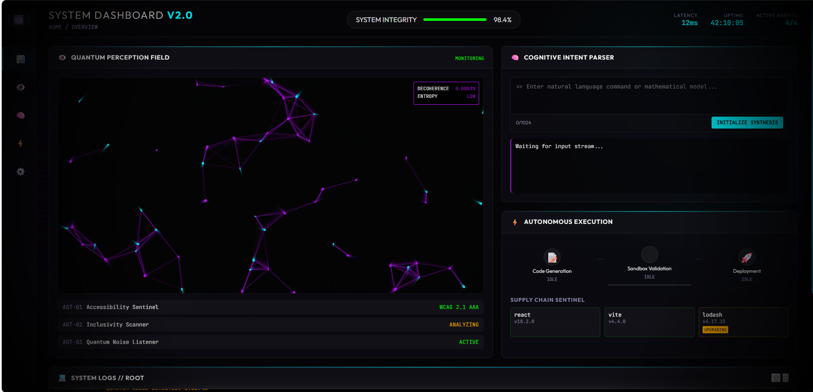
ADEG V2.0
AUTONOMOUS DIGITAL ECOSYSTEM GUARDIAN
The Self-Healing Software Revolution
[Name : SHIVANESH V]
[Team Name : Sentinel Systems | ADGE V2.0]
Galuxium Nexus V1 | November 2025

Slide 2
The Future of Software Maintenance
ADEG V2.0 is an autonomous AI agent system that monitors,
diagnoses, and repairs software ecosystems without human intervention.
━━━━━━━━━━━━━━━━━━━━━━━━━━━━━━━━━━━━━━━━
KEY METRICS
60% $300B+ 15%
Developer Annual Lost Population
Time Saved Productivity Served Better
━━━━━━━━━━━━━━━━━━━━━━━━━━━━━━━━━━━━━━━━
"We're not building tools. We're building digital organisms."

Slide 3
The Maintenance Crisis
━━━━━━━━━━━━━━━━━━━━━━━━━━━━━━━━━━━━━━━
CURRENT STATE IMPACT
⚠️ 60% of dev time on → Innovation stalls
maintenance, not innovation
⚠️ Accessibility often → 15% of users excluded
an afterthought → Legal compliance risks
⚠️ Manual dependency → Security vulnerabilities
management → Supply chain attacks
⚠️ Reactive bug fixing → Downtime costs
→ User frustration
━━━━━━━━━━━━━━━━━━━━━━━━━━━━━━━━━━━━━━━
Annual Cost: $300B+ in lost productivity

Slide 4
ADEG V2.0: Digital Immune System Architecture
━━━━━━━━━━━━━━━━━━━━━━━━━━━━━━━━━━━━━━
👁️ PERCEPTION 🧠 REASONING ⚡ ACTION
Monitor & Detect Analyze & Plan Execute & Deploy
• Quantum Noise • Intent Parsing • Code Generation
• Accessibility • Root Cause • Sandbox Testing
• Inclusivity • Solution Design • Auto Deployment
• Anomaly Detection • Risk Assessment • Supply Chain
━━━━━━━━━━━━━━━━━━━━━━━━━━━━━━━━━━━━━━
Continuous Feedback Loop → Self-Improvement

Slide 5
What Makes ADEG Different
━━━━━━━━━━━━━━━━━━━━━━━━━━━━━━━
🔬 QUANTUM-INSPIRED MONITORING
Pattern recognition at scale using advanced algorithms
inspired by quantum computing principles
🧬 AUTONOMOUS AGENT SWARM
Multiple specialized AI agents working in parallel,
each optimized for specific maintenance tasks

Slide 6
🗣️ NATURAL LANGUAGE INTERFACE
Developers communicate intent in plain English,
AI translates to executable actions
♿ ACCESSIBILITY-FIRST DESIGN
WCAG 2.1 AAA compliance built into the core,
not bolted on as an afterthought
━━━━━━━━━━━━━━━━━━━━━━━━━━━━━━━
First autonomous system combining productivity,
accessibility, and security in a single platform

Slide 7
Enterprise-Grade Technology Stack
━━━━━━━━━━━━━━━━━━━━━━━━━━━━━━━━━━━━━━━━
FRONTEND LAYER
├─ Vanilla JavaScript (ES6+) → Zero framework overhead
├─ Canvas API → Real-time visualization
└─ CSS3 Glassmorphism → Premium UX
INTELLIGENCE LAYER
├─ Natural Language Processing → Intent understanding
├─ Pattern Recognition ML → Anomaly detection
└─ Generative AI → Code synthesis
EXECUTION LAYER
├─ Event-Driven Microservices → Horizontal scalability
├─ Docker Sandboxing → Isolated testing
└─ CI/CD Automation → Zero-touch deployment

Slide 8
SECURITY LAYER
├─ Dependency Graph Analysis → Supply chain protection
├─ RBAC & Audit Logging → Enterprise compliance
└─ Encrypted Telemetry → Data protection
━━━━━━━━━━━━━━━━━━━━━━━━━━━━━━━━━━━━━━━━
Built for scale: 1M+ LOC, 1000+ agents, global deployment

Slide 9
Building an Inclusive Digital World
━━━━━━━━━━━━━━━━━━━━━━━━━━━━━━━━━━━━━━━
THE ACCESSIBILITY CRISIS
15% of the global population has a disability
70% of websites fail basic accessibility tests
$6.9B in annual lawsuit settlements (US alone)
━━━━━━━━━━━━━━━━━━━━━━━━━━━━━━━━━━━━━━━
ADEG'S SOLUTION
✓ Accessibility Sentinel
Continuous WCAG 2.1 AAA monitoring
✓ Inclusivity Scanner
Bias detection in code, content, and UX

Slide 10
✓ Automated Remediation
Fixes accessibility issues before deployment
━━━━━━━━━━━━━━━━━━━━━━━━━━━━━━━━━━━━━━━━
IMPACT: Making the web accessible to everyone,
automatically and at scale

Slide 11
Massive Addressable Market
━━━━━━━━━━━━━━━━━━━━━━━━━━━━━━━━━━━━━━━━
TARGET SEGMENTS
🏢 Enterprise Development Teams → 50M+ developers globally
☁️ SaaS & Cloud Platforms → $200B+ market
🏛️ Government & Public Sector → Compliance mandates
🌐 Open Source Projects → 100M+ repositories
━━━━━━━━━━━━━━━━━━━━━━━━━━━━━━━━━━━━━━━━
MARKET SIZE
DevOps Tools $10.3B (2024)
AI-Assisted Development $14.8B (Growing 40% YoY)
Accessibility Tech $2.1B (Regulatory driven)
Total Addressable Market: $27B+
━━━━━━━━━━━━━━━━━━━━━━━━━━━━━━━━━━━━━━━━
COMPETITIVE ADVANTAGE
Only solution combining autonomous maintenance,
accessibility compliance, and security monitoring

Slide 12
Scalable Revenue Strategy
━━━━━━━━━━━━━━━━━━━━━━━━━━━━━━━━━━━━━━━━
TIER 1: OPEN SOURCE CORE
Free for individual developers and small teams
→ Community growth & ecosystem development
TIER 2: PROFESSIONAL ($99/month per repo)
• Advanced agent customization
• Priority support
• Enhanced analytics
TIER 3: ENTERPRISE (Custom pricing)
• Multi-repo orchestration
• On-premise deployment
• SLA guarantees
• Dedicated agent training

Slide 13
TIER 4: MARKETPLACE (Revenue share)
• Third-party agent plugins
• Custom integrations
• Training datasets
━━━━━━━━━━━━━━━━━━━━━━━━━━━━━━━━━━━━━━━━
Year 1 Target: 10K free users → 500 paid conversions

Slide 14
Path to Production
━━━━━━━━━━━━━━━━━━━━━━━━━━━━━━━━━━━━━━━━
Q1 2025 | MVP LAUNCH
✓ Core autonomous agents (Perception, Reasoning, Action)
✓ Web dashboard interface
✓ GitHub/GitLab integration
✓ Basic accessibility scanning
Q2 2025 | ENTERPRISE FEATURES
□ Multi-repository support
□ Custom agent training
□ Advanced analytics & reporting
□ Slack/Teams integration
Q3 2025 | ECOSYSTEM EXPANSION
□ Agent marketplace launch
□ Community-contributed agents

Slide 15
□ API for third-party integrations
□ Mobile monitoring app
Q4 2025 | SCALE & OPTIMIZE
□ Edge deployment for low latency
□ GPU-accelerated ML models
□ Enterprise SLA guarantees
□ ISO 27001 certification
━━━━━━━━━━━━━━━━━━━━━━━━━━━━━━━━━━━━━━━━
Vision: Every codebase has an autonomous guardian by 2026

Slide 16
See ADEG in Action
━━━━━━━━━━━━━━━━━━━━━━━━━━━━━━━━━━━━━━━━
[Large screenshot of dashboard with callouts]
1️⃣ Quantum Visualizer
Real-time particle-based monitoring
2️⃣ Natural Language Interface
"Fix the login timeout" → Autonomous execution
3️⃣ Accessibility Sentinel
WCAG 2.1 AAA compliance in real-time
4️⃣ Autonomous Pipeline
Code Gen → Validation → Deployment
━━━━━━━━━━━━━━━━━━━━━━━━━━━━━━━━━━━━━━━━
🎥 Full Demo Video: [Link]
💻 Live Dashboard: https://github.com/ShivaneshV/Autonomous-Digital-Ecosystem-Guardian

Slide 17
Built by Team
━━━━━━━━━━━━━━━━━━━━━━━━━━━━━━━━━━━━━━━━
SHIVANESH V
Founder & Lead Developer | Sentinel Systems
ROLES & CONTRIBUTIONS:
• Full-Stack Development (100%)
→ Built complete web dashboard with advanced visualizations
• System Architecture (100%)
→ Designed three-layer autonomous agent architecture
• UI/UX Design (100%)
→ Created premium cyberpunk aesthetic and HUD interface
• AI/ML Integration (Conceptual)
→ Architected NLP-based intent parsing and code generation
• Accessibility Engineering (100%)
→ Integrated WCAG 2.1 AAA compliance monitoring

Slide 18
CONTACT
📧 shivanesh995@gmail.com
🔗 www.linkedin.com/in/shivanesh-v
💻 https://github.com/ShivaneshV/ShivaneshV

